Slide 1
Temporal Aggregation for Dense Video Captioning
CS6240 Project
Presenter: Dipika Singhania, Huiqi Mao

Slide 2
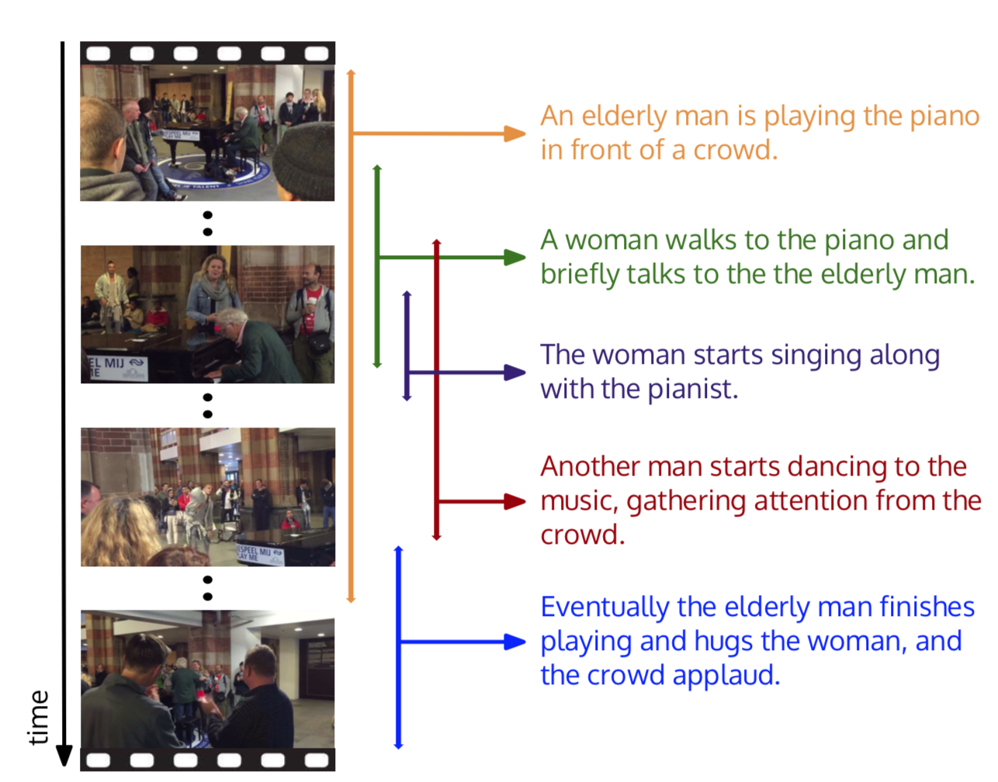
What is Dense Captioning?
Dense captioning involves detecting multiple events that occur in a video and describing each event using natural language.

Slide 3
Why Dense Captioning?
“an elderly man playing the piano in front of a crowd”
Fails to recognize and articulate all the other events in the video

Slide 4
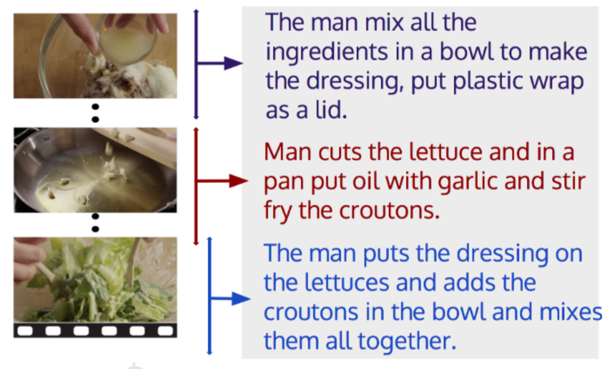
Motivation
Combining global and local information is important in event proposal and captioning
Especially when dealing with long videos

Slide 5
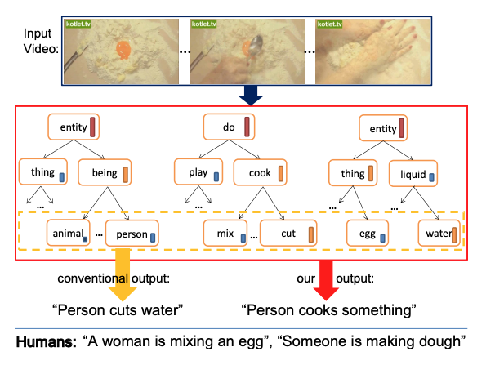
Related Works
Classical Template Based Video Captioning
Entities such as objects, actions and scenes are first detected and then fit to pre-defined sentence templates.
E.g. SVO (Subject, Object, Verb) tuple-based methods
Pros and cons:
Pros: good grammar
Cons: constraints on sentence generation. Limit creativity.

Slide 6
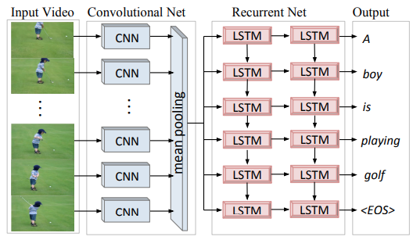
Related Works
Deep Learning Based Video Captioning
Encoder-decoder structure, CNN and RNN
Examples:
Translating videos to natural language using deep recurrent neural networks[1] first proposed LSTM-based model and use mean pooling representations over all frames.
Temporal Attention based method, Hierarchical recurrent neural encoder for video representation with application to captioning [2] was later proposed to use temporal attention mechanism.
[1] Subhashini Venugopalan, Huijuan Xu, Jeff Donahue, Marcus Rohrbach, Raymond 640 Mooney, and Kate Saenko. 2014. Translating videos to natural language using deep recurrent neural networks. arXiv preprint arXiv:1412.4729 (2014).
[2] Pingbo Pan, Zhongwen Xu, Yi Yang, Fei Wu, and Yueting Zhuang. 2016. Hierarchical recurrent neural encoder for video representation with application to captioning. In Proceedings of the IEEE Conference on Computer Vision and Pattern Recognition. 1029–1038.

Slide 7
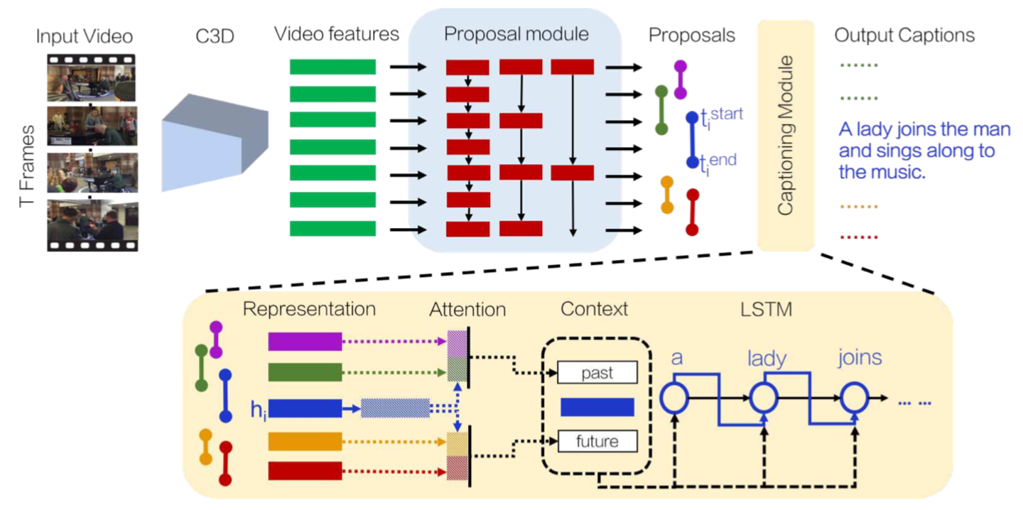
Related Works
Dense Video Captioning
Typically has two modules: event proposal + captioning module
E.g. Dense-captioning events in videos [3] uses a two-stage system. It detects events with simple objective of binary classification and use LSTM to describe each proposal. End-to-end dense video captioning with masked transformer [4] uses non-recurrent structure, self-attention transformer mechanism.
[3] Ranjay Krishna, Kenji Hata, Frederic Ren, Li Fei-Fei, and Juan Carlos Niebles. 2017. Dense-captioning events in videos. In Proceedings of the IEEE international conference on computer vision. 706–715.
[4] Luowei Zhou,Yingbo Zhou,Jason J Corso,Richard Socher,and Caiming Xiong. 2018. End-to-end dense video captioning with masked transformer. In Proceedings 657 of the IEEE Conference on Computer Vision and Pattern Recognition. 8739–8748.

Slide 8
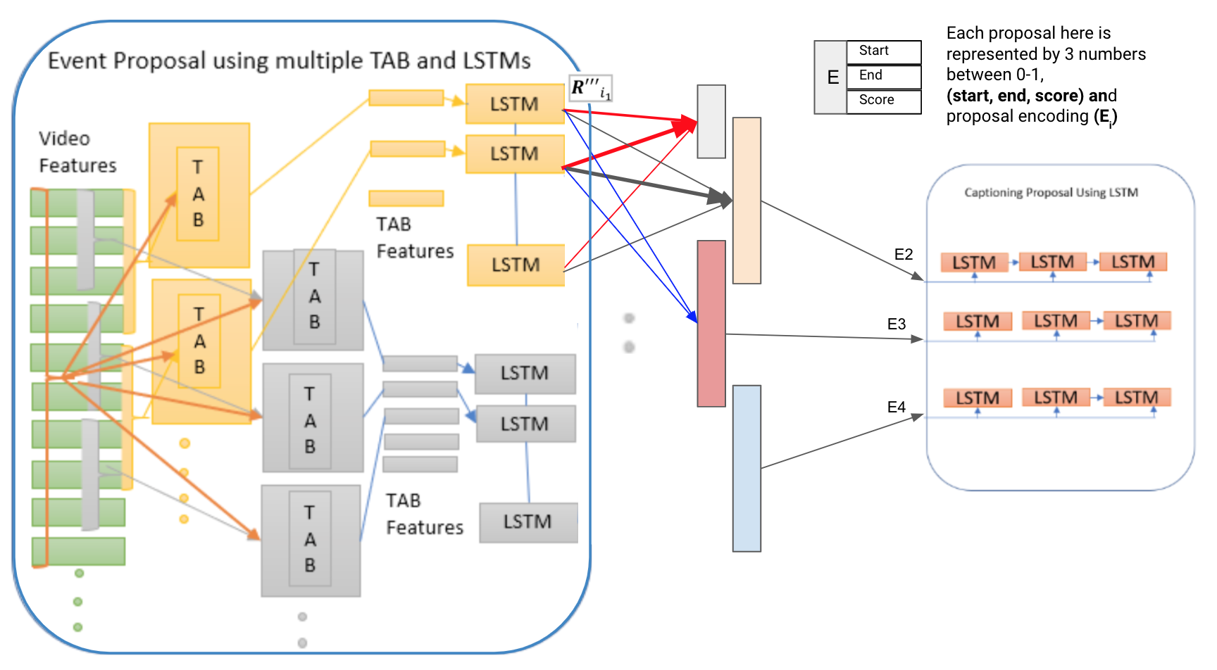
Model
TAB - Temporal Aggregation Block
Recent features: [30, 50]
Spanning features: [10, 15, 20]

Slide 9
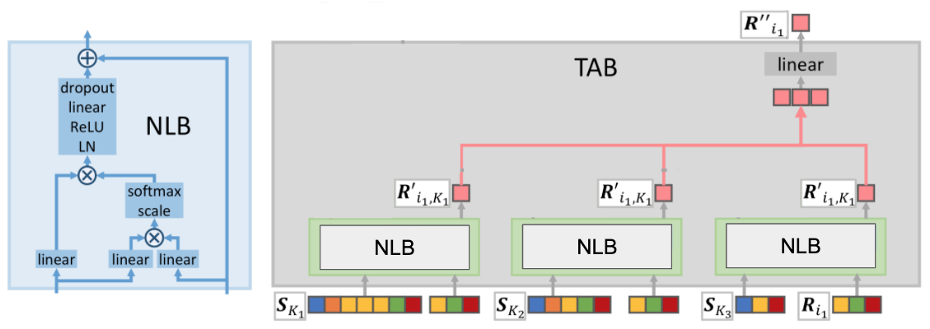
Model
Non-Local Block (NLB)
Computes attention-reweighted local snippet representations
Temporal Aggregation Block (TAB)
Aggregates the representations from NLBs

Slide 10
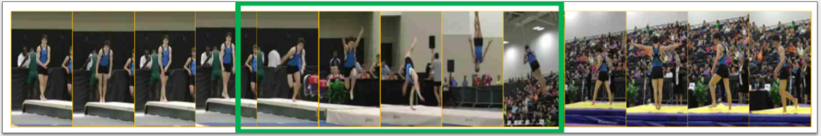
How do we represent a Event Proposal?
We consider N=27 proposals
Each proposal j is represented by (start_{J}, end_{j}, score_{j,}, E_{j})
E_{j} = 1024 dimension
10 sec
score_{j} = 0.8
40 sec

Slide 11
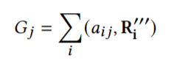
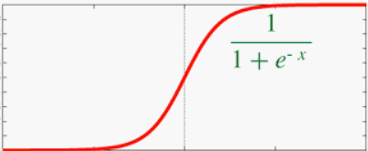
How do network learn to predict the start, end and score for each proposal ?
Each proposal is weighted average of all LSTMs outputs.
2s LSTM
Proposal(j)
4s LSTM
ratio_{start} = 0.21
6s LSTM
8s LSTM
ratio_{len}= 0.45
10s LSTM
12s LSTM
score_{j} = 0.8
14s LSTM
16s LSTM
18s LSTM
20s LSTM
start_{j} = 0.21 * 28s = 5.88 s
end_{j} = 0.45 * (28 - 6)s = 9.9 s
22s LSTM
24s LSTM
26s LSTM
Start, end and score is averaged across different LSTMs
28s LSTM

Slide 12
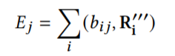
How do network learn to encode each proposal ?
Each proposal is weighted average of all LSTMs outputs.
2s LSTM
4s LSTM
Proposal(j_1)
Proposal(j_2)
4s LSTM
6s LSTM
8s LSTM
8s LSTM
10s LSTM
12s LSTM
10s LSTM
12s LSTM
12s LSTM
14s LSTM
16s LSTM
14s LSTM
16s LSTM
16s LSTM
18s LSTM
18s LSTM
20s LSTM
20s LSTM
20s LSTM
E_{j_1}
E_{j_2}
22s LSTM
22s LSTM
24s LSTM
24s LSTM
24s LSTM
E_{j}
26s LSTM
26s LSTM
28s LSTM
28s LSTM
28s LSTM

Slide 13

Objective of Event Proposal Module
score predicts the possibility of proposal to contain an event and is minimized with BCE Loss with ground truth binary value 0 or 1
start, end for each proposal is minimized with Mean Square Error loss across each proposal

Slide 14
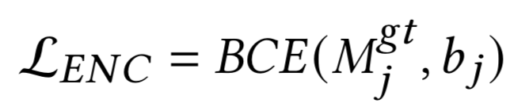
Objective of Encoding Proposal Module
Encoding proposal module tries to encode proposal containing event.
Objective to learn the attention weights to be equals to binary proposal mask for valid proposal
Size of recent {R_k} used {30, 50}
Ground Truth Proposal Binary Mask
Proposals
0.1 | 0.6 | 0.6 | 0.2
0.6 | 0.6 | 0.2 | 0.3
0.1 | 0.1 | 0.1 | 0.1
0.2 | 0.2 | 0.2 | 0.2
0 | 1 | 1 | 0
1 | 1 | 1 | 0
0 | 0 | 0 | 0
0 | 0 | 0 | 0

Slide 15
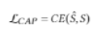
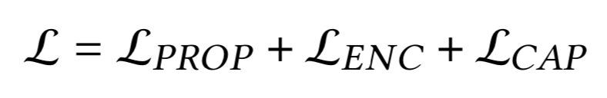
Objective of Model
Vocab module uses the encoding of each proposal,concatenates it with word sequence to train the LSTM to decode the captions for each proposal
Does we train the network in an end-to-end fashion to reduce the Proposal, Encoding and Captioning loss.

Slide 16
Experimental Setup
Features Used:
1-D appearance feature for 1024 dimension
Optical Flow from BN-Inception of 2048 dimension.
Adam Optimizer:
Learning rate 1e-4 for event proposal
Learning rate 1e-2 for event captioning
Training Time and Epochs
Trained for 100 epochs to get the final results
Around 8 hours training time(5 mins per epoch)

Slide 17
Experimental Setup
Max Proposals per Video:
27
Recent Divisions used:
{30, 50}
Spanning past divisions used
{10, 15, 20}

Slide 18
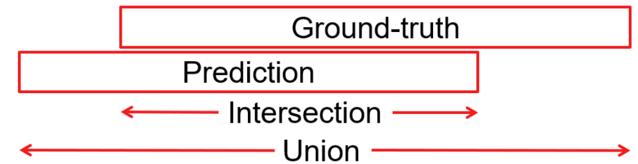
Evaluation Metric and Final Model Results
IOU | 0.3 | 0.5 | 0.7 | 0.9 | Average
Bleu_1 | 10.22 | 10.72 | 9.78 | 1.88 | 8.2
Bleu_2 | 3.35 | 3.57 | 3.39 | 0.79 | 2.9
Bleu_3 | 1.18 | 1.33 | 1.26 | 0.28 | 1.1
Bleu_4 | 0.36 | 0.46 | 0.57 | 0.15 | 0.5
METEOR | 3.76 | 4.00 | 3.84 | 0.88 | 3.2
ROUGE_L | 11.46 | 12.05 | 10.42 | 1.26 | 8.5
CIDEr | 6.90 | 8.69 | 11.58 | 2.50 | 8.4
Recall | 79.44 | 67.28 | 45.08 | 4.59 | 44.1
Precision | 99.64 | 98.66 | 71.97 | 7.03 | 63.7

Slide 19
Experimental Results for Component Validation
Is coupling of local features with global features with use of Temporal Aggregates module useful for the event proposal module?
We remove the TABs keeping the recent divisions fixed to {30, 50}
+3.6 % improvement in event proposal using TABs
Method Used 𝐾_{r} = {30, 50} | Average Recall Score(%) | Average 𝑅𝑂𝑈𝐺𝐸_𝐿 Score
Without using TABs | 40.08 | 7.7
Using TABs | 43.68 | 7.2

Slide 20
Experimental Results for Component Validation
Is using multiple division for incorporating various scales of event useful?
{30, 50} proposals shown better results than other splits
Recent Division 𝐾_{r} | Average Recall Score(%) | Average 𝑅𝑂𝑈𝐺𝐸_𝐿 Score
{30} | 40.90 | 6.96
{50} | 41.52 | 7.14
{30, 50} | 43.68 | 7.16
{30, 50, 70} | 41.59 | 6.86

Slide 21
Experimental Results with SOTA results
We have lower scores than SOTA results. Reason could be because of slightly different settings.
Methods | Max Proposals | Average Recall % | Meteor Score %
Masked Transformers[1] | 1000 | 52.95 | 9.25
Dense Event Captioning[2] | 1000 |  | 4.82
ProcNets Proposals[3] | 1000 | 47.01
Ours | 27 | 44.07 | 4.15
[1] Maksed Transformer, CVPR’ 2018
[2] Dense-captioning events, CVPR’ 2018
[3] Automatic Learning procedures, AAAI’ 2018

Slide 22
Reason for lower Scores
Considering only 27 max proposals per video might be possible reason:
Reduces chances of predicting correct proposal
Less proposals being trained to caption the data
Advantages:
Can be trained in less time 8 hours compared to 2 days training for other models
It reduces the multiple random proposal selection and decoding time
Average Precision of proposals becomes more than recall

Slide 23
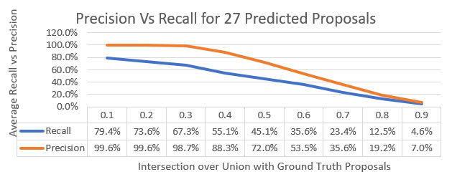
Reason for lower Scores
Advantages:
Can be trained in less time 8 hours compared to 2 days training for other models
It reduces the multiple random proposal selection and decoding time
Average Precision of proposals becomes more than recall

Slide 24
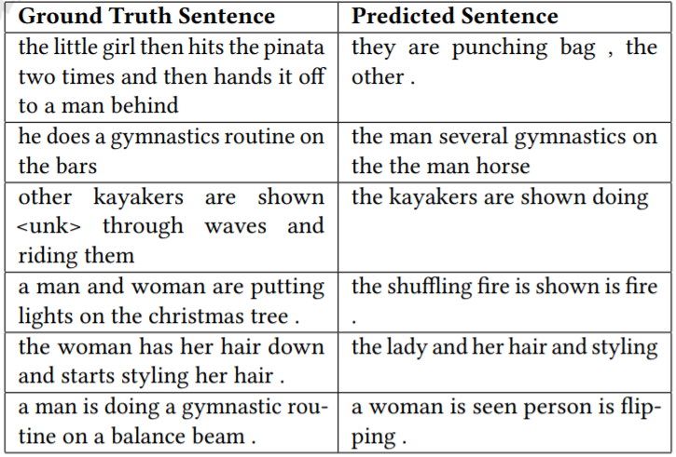
Qualitative Examples of Captioning Module

Slide 25
Conclusions
Inspired by success of attention weights and relating recent with global feature used for action recognition in video [1], we experiment the concept for captioning
Different from proposing 1000’s of proposals and formulating dense captioning as selection among 1000 proposals approach, we try to predict the fixed maximum 27 proposals per video and its proposals masks.
We reduce in training and decoding time, but are was not able to reach the state of the art performance.
The captioning can be made more grounded with use of Object detection and Action Recognition with the encoded proposal feature.
[1] Long-term feature bank, CVPR ’2019

Slide 26
Future Work
We have poor captioning scores. If we can pretrain the LSTM’s with the ground truth proposals to learn to decode sentences we can improve on current results
We are predicting ground truth proposal mask in regression and binary encoding, but are unable to relate them together in the network.
We can convert our current setting to predicts 1000s of proposals and verify its performance.

